Slide 1
A.Y. Jackson
1882 – 1974

Slide 2
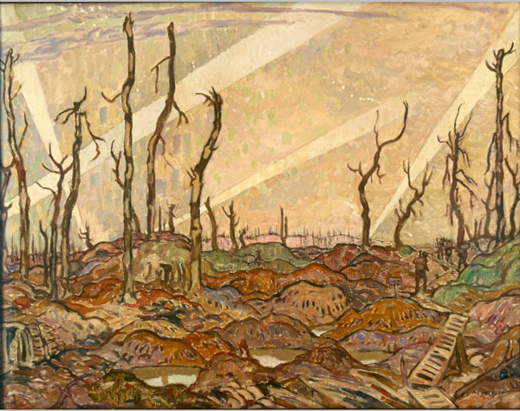
ONE OF CANADA’S FIRST WAR ARTISTS
In 1914, Jackson was 32 and already famous as a Canadian artist.
Volunteered in 1915 and was sent overseas with the 60th Battalion
Wounded in the shoulder and hip in June 1916
Sent to England to heal and met Lord Beaverbrook
Appointed as an artist with the Canadian War Records.
Notes:
Jackson could have stayed home or found a way not to go overseas. He felt it was his patriotic duty to go, so he VOLUNTEERED and went over as a regular soldier. While recovering, he met Lord Beaverbrook and was soon appointed as an artist to document the war. He had to paint a portrait, but most of his work was LANDSCAPES.

Slide 3
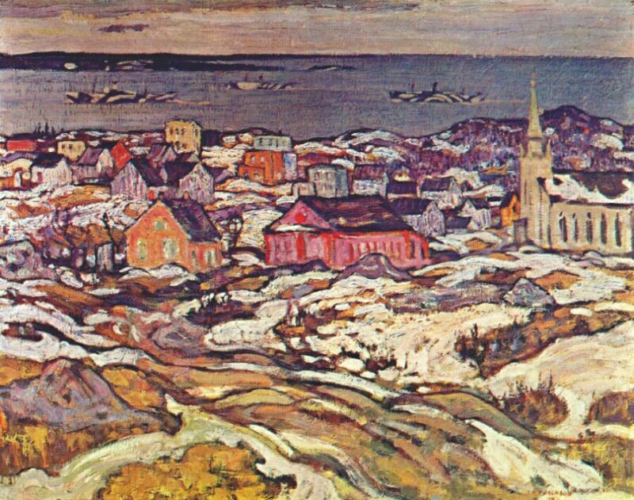
TURNING WAR INTO ART
Became one of Canada’s FIRST war artists
Sent to document, sketch and paint
First subject was Vimy Ridge AFTER the battle
Painted and sketched close to Passchendaele WHILE the battle raged.
He was discharged in 1919
Notes:
Artists were used to document battles because cameras were still not easy to carry around, especially in battle. They were big and very heavy. Instead of film, they used GLASS negatives. Jackson painted VIMY RIDGE after the battle and close to Passchendaele WHILE the fighting was going on!! From 1917 to 1919, he worked for the Canadian War Memorials as an artist. He was discharged in 1919.

Slide 4
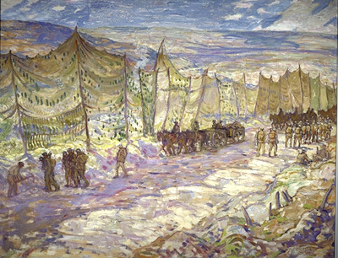
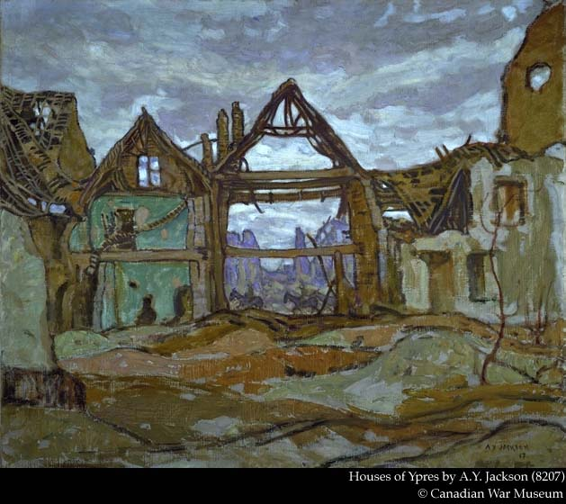
PAINTING THE EXPERIENCE
Notes:
A.Y. Jackson painted more canvases for the War Office than any other artist.
To the left is on of Jackson’s paintings showing troop movements back and forth to the front behind tall camouflage barriers. In an era before drones and many planes, screens kept the enemy from being able to count soldiers and movement. To the right is “Houses of Ypres” where Jackson turns the bombed and burnt out buildings into frames and shapes that are beautiful despite the horrors of war.

Slide 5
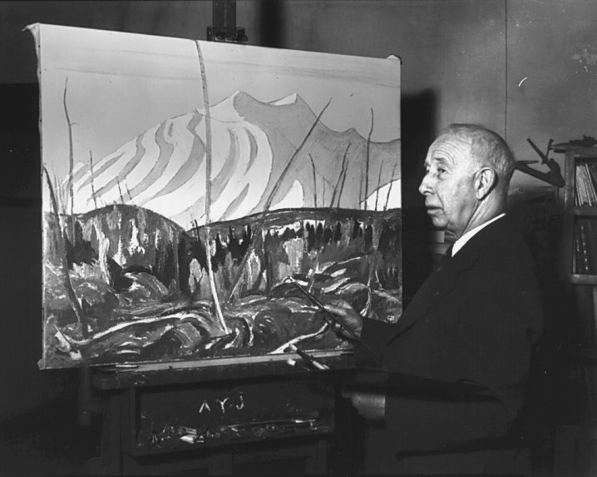
GROUP OF SEVEN ARTIST
During WW II, Jackson remained on Canadian Soil but strongly supported the War Art Program.
Created a learn to paint book for soldiers to help them deal with stress.
Suffered a stroke 6 years before his death in 1968 which ended his painting career.
Notes:
Jackson did not go overseas for WW II but did remain very involved in the War Art Program. Remembering his time as a soldier, he created a book to teach soldiers to deal with stress by painting in their down time. The hardest part of his life was when a stroke SIX FULL YEARS before his death, ended his painting career. He found it hard not to do something he loved SO much that was such a big part of who he was.

