Slide 1
Georgia O’Keefe
1887 - 1986

Slide 2
FLOWERS AS ART - Red Poppy 1927

Slide 3
ORIENTAL POPPIES 1928
Georgia O’Keefe is famous
for turning the ordinary beauty
of flowers into abstract art.

Slide 4
FROM FLOWER TO SHAPES
The longer that O’Keefe worked
on paintings of the same theme
or flower, the more abstract
the shapes became.

Slide 5
Georgia O’Keefe
She lived for 40 years after the death of her husband,
famous photographer Alfred Stieglitz,
who was 23 years older than her.

Slide 6
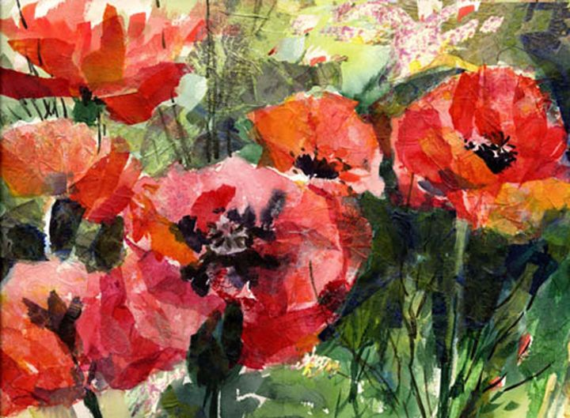
Other Poppy Options

