Slide 1
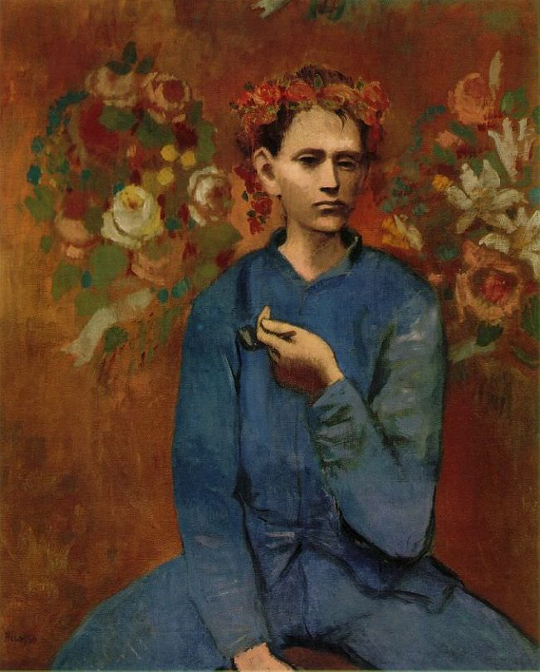
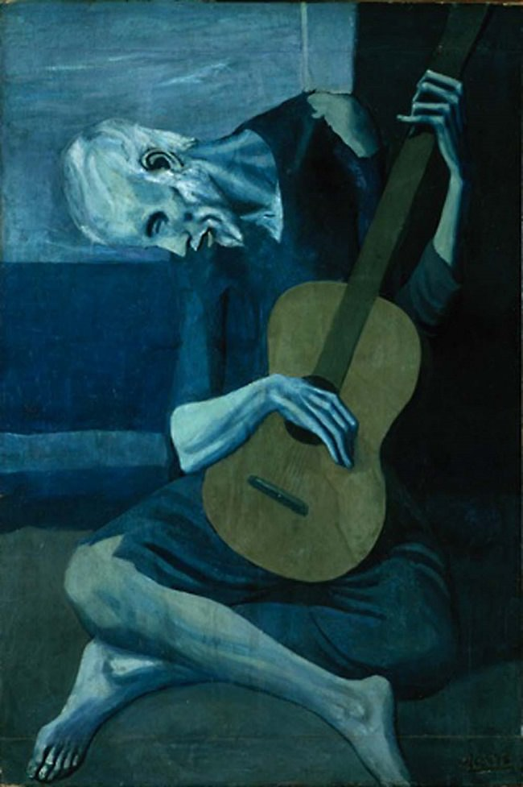
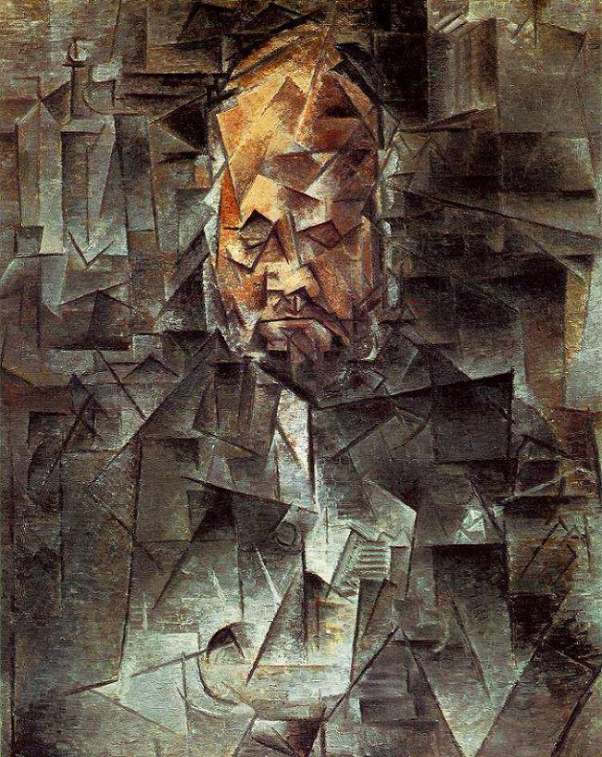
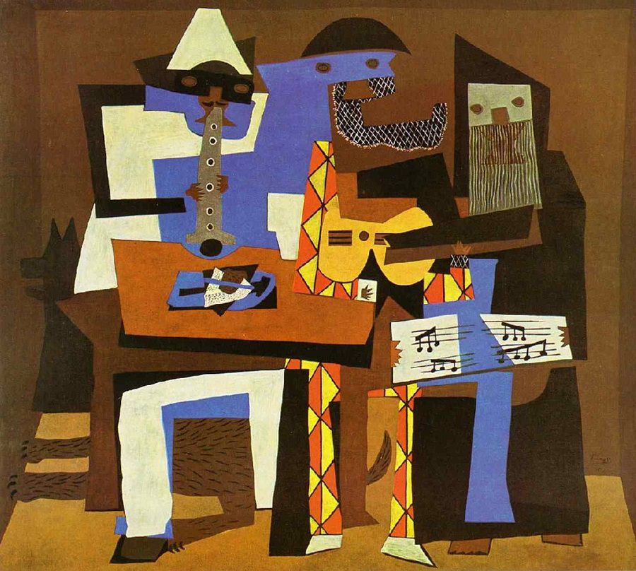
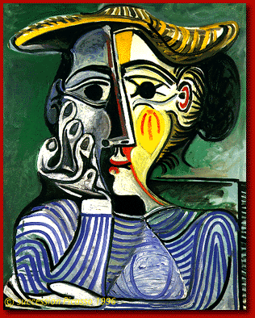
Pablo Picasso
1881-1973
Notes:
PICASSO SAW THE SAME HUGE CHANGES FROM THE END OF THE 19th CENTURY TO THE 20th AS THE OTHEER ARTISTS THIS YEAR- GEORGIA O'KEEFE and A.Y. JACKSON. THE INVENTION OF THE CAMERA MEANT THAT ARTISTS HAD TO EXPLORE OTHER WAYS OF BEING CREATIVE TO KEEP FROM BEING REPLACED.

Slide 2
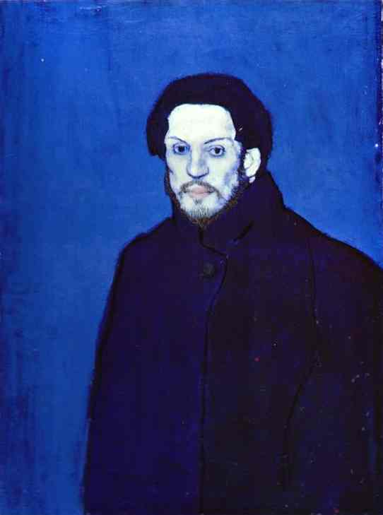
Early talent leads to exploration…
Pablo Picasso was a Spanish born painter, sculptor, printmaker, stage designer, poet, and playwright. He lived most of his adult life in France. His father, Ruiz, was a professor of painting who declared that Pablo at 13 was a better painter than he was as an adult.
Self-Portrait - 1901
“All children are artists. The problem is how to remain an artist once he grows up.”
Garçon à la pipe - 1905
Notes:
MANY PEOPLE SAY THAT PICASSO COULD NOT PAINT IN A REALISTIC WAY, BUT THESE PAINTINGS PROVE OTHERWISE. PICASSO WAS ONLY 13 WHEN HE ‘OUTPAINTED” HIS FATHER. PICASSO HAD MANY WAYS OF BEING CREATIVE, NOT JUST WITH PAINT.

Slide 3
Different Periods…
Picasso explored many different styles and moods in his art throughout his long and lucrative career. A few of his most famous periods are:
Blue Period 1901-1904
Rose Period 1904-1906
Cubism 1909-1919
Neo Classicism & Surrealism 1919-1929
The Old Guitarist 1903
Notes:
EVERY TIME PICASSO GOT GOOD AT A NEW STYLE OR GREW BORED OF PAINTING A CERTAIN WAY, HE TRIED TO FIND SOMETHING NEW TO KEEP HIS INTEREST. WHEN HE FIRST STARTED OUT, HE WAS POOR AND HUNGRY, HIS BEST FRIEND HAD DIED AND HE WAS TRYING TO COMMENT ABOUT HOW FRAGILE LIFE WAS.

Slide 4
CUBISM
Cubism gets its name from the breaking down of images into fractured shapes. This is one of the paintings that inspired your Warm or Cool colour shapes project.
Picasso CO-FOUNDED the Cubism Movement with Georges Braque and CO-INVENTED the COLLAGE!
Portrait of Ambroise Vollard 1910
Notes:
CUBISM WAS BREAKING DOWN IMAGES INTO LITTLE GEOMETRIC SHAPES. COLLAGE WAS RIPPING UP BITS OF PAPER, CUTTING SHAPES AND GLUING THEM TOGETHER. THE WORD COLLAGE STEMS FROM THE FRENCH WORD FOR GLUE- LA COLLE

Slide 5
Playing with colour and shapes…
Even when shapes became simplified or the colours limited, Picasso still put in enough hints that the viewer could recognize certain themes or objects.
3 Musicians - 1921
Notes:
NO MATTER HOW ODD THE SHAPES GOT IN PICASSO’S WORKS, THERE WAS ALWAYS AN IMAGE AT THE ROOT OF IT. IT WAS NEVER PURE ABSTRACT ART OF JUST COLOURS AND SHAPES WITHOUT AN IMAGE.

Slide 6
A lifetime of change…
Picasso was never afraid to explore, try new things or do the unexpected, no matter what other people thought. He is considered one of the most influential artists of the 20th century and his artwork is part of private and public collections around the world.
“Everything you can imagine is real.”
Woman with yellow hat - 1961
Notes:
PICASSO CONTINUED TO TAKE RISKS AND EXPLORE HIS CREATIVITY INSTEAD OF STAYING WITH ONE SAFE, MARKETABLE STYLE. THIS IS WHY HE REMAINS SUCH A FAMOUS AND INFLUENTIAL ARTIST.

